Slide 1
Cloud Security
Build fast. Stay secure. The next level of Cloud Security
Version 1.3 | January 2019
Notes:
Hello etc.
Today I am going to discuss the evolution of security in the cloud and how we may approach cloud security in the future.

Slide 2
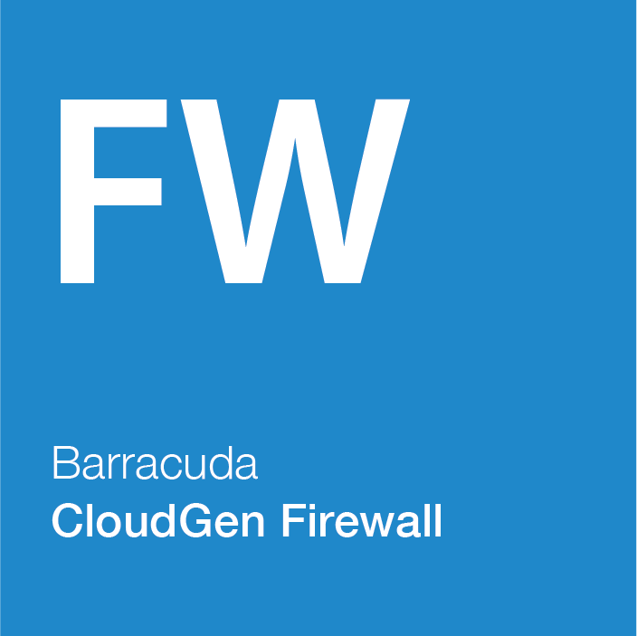
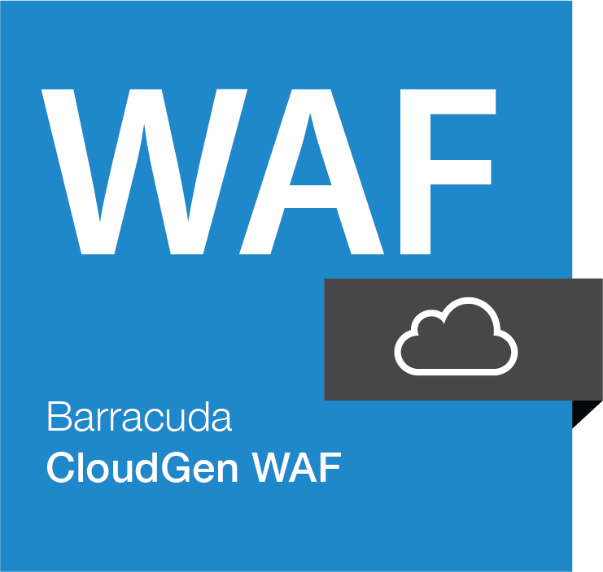
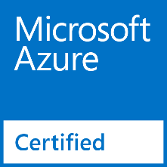
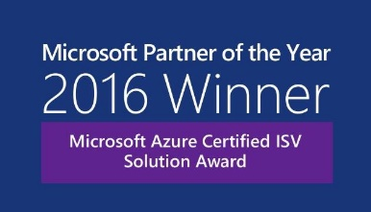
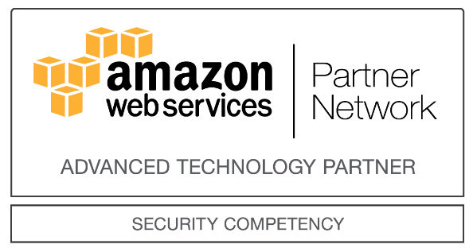
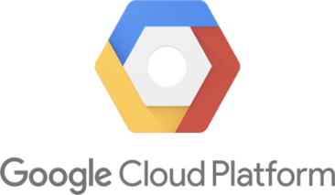
Barracuda Cloud Generation Firewalls
Notes:
Who we are!
Barracuda are a established Security provider with a product portfolio across Data Protection, Email Protection and Security.
The reason I am with you today is because Barracuda were the first to provide a security solution in public cloud. So we have had the opportunity to learn and develop our solutions alongside the Azure, AWS and Google cloud platforms.

Slide 3
Know your responsibilities
The Shared Security Model
Customer Applications & Content
YOU define controls and security IN the Cloud
You
Network Security
Identity & Access Control
Operating Systems / Platform
Data Encryption
Azure Platform
Cloud takes care of the Security OF the Cloud
Microsoft Azure
Physical Infrastructure
Network Infrastructure
Virtualization
Layer
Notes:
Do you recognise this slide?
This is the Shared Security model, as initially explained by Microsoft for Azure.

Slide 4
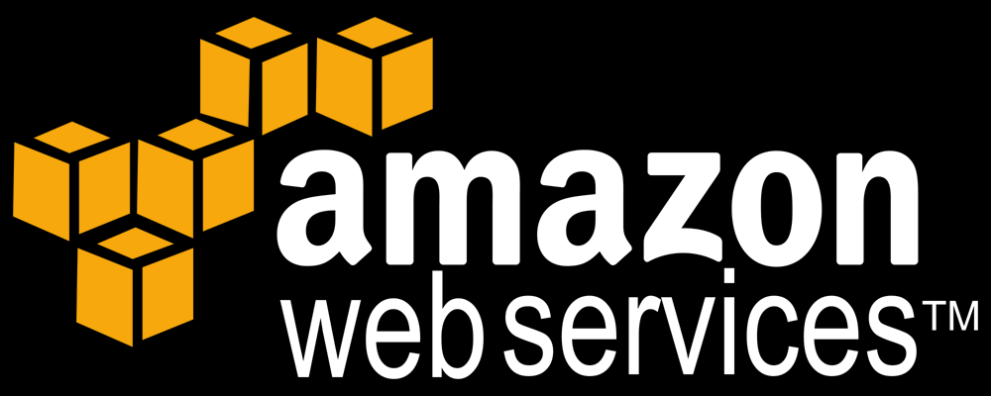
Know your responsibilities
Customer Data
Customer
Platform, Applications, Identity & Access Management
Responsible for security in the Cloud
Operating System, Network & Firewall Configuration
Client-side Encryption
Server-side Encryption
Traffic Protection
Compute
Storage
Database
Networking
Responsible for security of the Cloud
AWS Global Infrastructure
Regions
Edge Locations
Availability Zones
Notes:
Every cloud provider has one and these represented one of the first ways of addressing security within the cloud.
It has been an easy assumption to make, that once something is in the cloud everything is taken care of. The old, if my storage is replicated 6 times, then I don’t need to take backups, yay.
Of course now things have moved on…

Slide 5
How will you consume Cloud?
Lift and Shift
New
Notes:
With many companies taking a Cloud First approach to any new projects and datacentre refreshes, then one of the first questions is what type of cloud solution are you looking at?
Many legacy applications will perhaps require a lift and shift approach as refactoring the solution is not cost-effective. However many new solutions are going to be created directly in PaaS and SaaS offerings.
Keeping the Shared Security model in our minds then not only do our responsibilities change but the tools we have available to secure the solution will vary greatly.

Slide 6

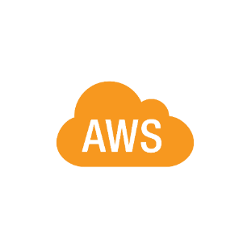

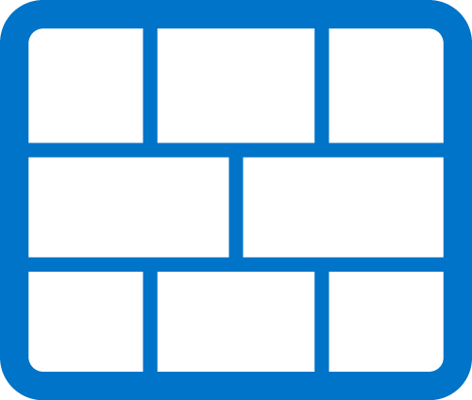

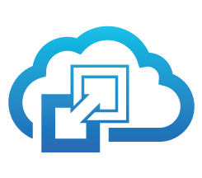
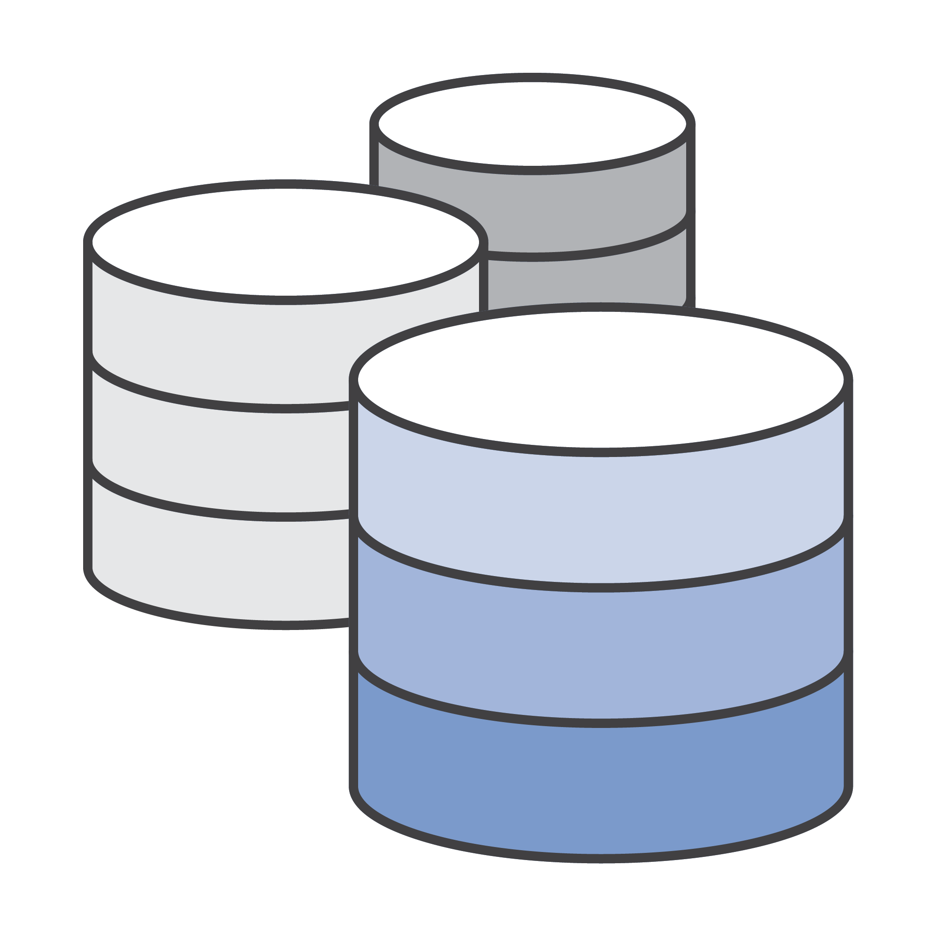

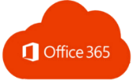




From Next Generation to Cloud Generation
Cloud Gen
Horizontal Scaling
Distributed Policy
Central Management
Secure Connectivity
No-MPLS
Traffic Regulation
0-touch deployment
Visibility
Security at source
Elastic Scaling
Dispersed Workloads
Orchestration API
Support Cloud Use Cases
Cloud Integrations
Flexible Licensing
Vertical Scaling
Backhauled Networks
Aggregated Policy
Monolithic Architecture
“Feature” Heavy
Not Orchestrated
Expensive
Next Gen
Notes:
Let’s take a look first at where we have been, at the traditional architectures we have been deploying for decades.
Over this time best practice have developed to place security devices at the perimeter and funnel traffic through these devices to be inspected. In large corporate networks there may be many datacenters connected together with high performance fixed lines.
Within these locations we have options to segregate traffic in these locations with switches & vlan tagging. To dedicate performance by allocating exactly the bandwidth with need and use QoS.
With more cloud solutions being consumed however and a more mobile workforce then dragging all the traffic back to a central point for inspection starts to become costly. New solutions need to be considered to place the right security in the right place to protect your organization but enable your users.

Slide 7

Barracuda Cloud Generation Firewall
Notes:
So let’s talk first about IaaS migrations, these resemble mini data centres in the cloud and so share the most practise with what we would do in our datacentre.
Still things aren’t quite the same, the cloud is evolving every day and so each time security must evolve with it. I’m going to start by talking about firewalling in the cloud.

Slide 8

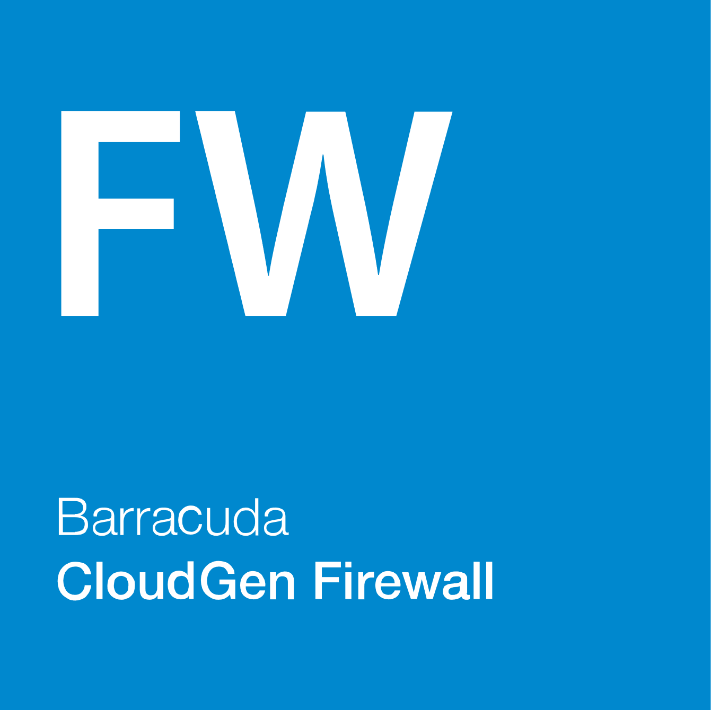
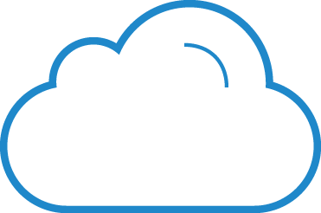
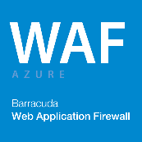



Cloud Architecture
Single VNET – Reference Architecture
FW Tier
WAF Tier
Web Tier
App Tier
DB Tier
Notes:
Once upon a time Azure didn’t have quite so many features, networking was quite basic and security even more so.
The first NVA’s in the cloud could only operate with single NIC’s. Further HA was a bit of a challenge due to the lack of Layer 2 features that we rely on on-premise. This posed problems for some.
But with the release User Defined Routes in Azure and Route Tables in AWS and that enabled HA designs like so;
This meant the Barracuda Firewall could now manage via the API the routes in the cloud, which made the first proper HA deployments possible.
With routes under our control the Layer 7 capabilities of these devices could be used effectively, features like URL filtering, IDS/IPS , Malware scanning become available.

Slide 9

Cloud Architecture
NSG
UDR
UDR
UDR
Internal Tier
NSG
UDR
NSG
NSG
NSG
App Tier
DB Tier
UDR
External Tier
NSG
Notes:
Next came NSG’s and Multi-NIC / Multi-IP features. This opened the door for more complex designs and gave the feel of the segregation we would perform on premise.
However there are a few things that won’t quite operate the same in Cloud.
- Multiple-NIC’s – don’t separate traffic anymore
- don’t improve bandwidth
-can make routing complicated
-combining Firewalls with NSG’s can make management and troubleshooting super complicated.

Slide 10
Cloud Architecture
Standard Load Balancer Design
App Tier
External
LB
Internal
LB
FW Tier
Web Tier
DB Tier
Notes:
In Azure the latest feature introduced is the Standard LB, this allows NVA’s to be deployed in Active/Active solutions. But the Standard network SKU’s also had one other unique difference, these were the first features to be introduced that were closed by default. Without an NSG to control traffic a deployment using Standard LB or IP’s will block.
This advance means that Firewall appliances can be introduced into more interrupt sensitive traffic flows or ones that require higher throughput than a traditionally A/P design will allow. Even more control over the traffic can be achieved in the environment again restoring functions that we wouldn’t think twice about in a datacentre.

Slide 11
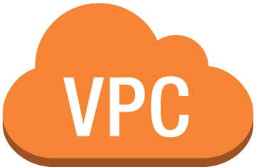
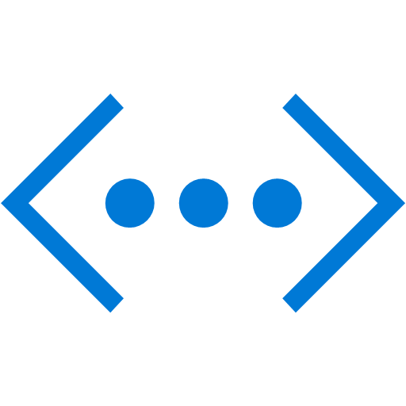

Across Clouds
Transit
Hub
Notes:
Able to integrate with both Microsoft Azure vWAN feature and AWS’s Transit Hub means that Barracuda can help bridge the connectivity gap while providing a security boundary between the two clouds.
While each team can work in the cloud that suits their needs the Barracuda products can overlay both clouds with a common security platform.
Demo

Slide 12
Cloud Architecture
Distributed Design
Dev
Prod
Egress/ VNET
Prod DB
Staging
Infra
Notes:
Network designs in the cloud are still very fluid with no single best practice having yet developed that can meet all use cases. However with a Central Management solution the Barracuda CGF can be very easily deployed in a distributed design allowing the firewalls to provide security to each environment. RBAC means that the Dev team can manage their devices without affecting or having any access to production controls.
As performance limits in the cloud are instance based, this distributed approach allows performance to be targeted where needed and often provides a better experience at equivalent or lower cost than larger boxes.

Slide 13

Most Common Use Cases
VPN Tunnels
Unlimited site-to-site VPN tunnels to connect two networks protected by F-Series Firewalls
Multi-Tier Architecture
Build secure multi-tier architecture in Azure to keep a level of segregation between tiers
ExpressRoute
Visibility and control on all traffic coming across the ExpressRoute connection
Traffic Control
Inbound/outbound traffic control while providing IPS/IDS functionality
Access to Resources
Access to resources in Azure (unlimited client-to-site VPN, SSL VPN)
Notes:
As you can see there are a number of different approaches for designing the security within IaaS. These often depend upon the features available at deployment time, the requirements of the infrastructure and the locations security is needed in.
So to sum up, within IaaS infrastructure designs there remains a need for firewall devices to provide levels of inspection beyond cloud native technology, to help pull together different connectivity solutions and provide integration and functionality not present in the cloud platform or in a unique use case.
Of course Firewalls even with features such as IDS/IPS, Malware protection and Zero Day protection can only go so far and as your applications move out of the IaaS and into PaaS and service endpoints then we may start looking towards a different type of security.

Slide 14
Barracuda Web Application Firewall
Notes:
Web Application Firewalls.
In case you weren’t aware can be specialist devices, dedicated to the inspection and protection of HTTPS/HTTP endpoints.

Slide 15




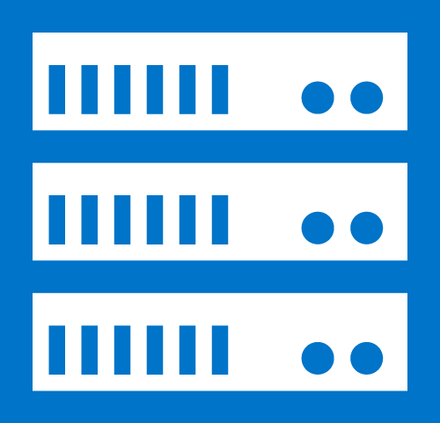


Comprehensive Application Security
OWASP Top-10 Attacks
Application DDOS
Data Loss Prevention
Credit Card Numbers
Social Security Number
Custom Patterns
Proactive Defense
Geo-IP Control
Application Cloaking
Inbound Inspection
Outbound Inspection
Authentication & Access Control
Logging & Reporting
Notes:
The Barracuda WAF is a dedicated device which is intended to provide protection for any exposed web service endpoint.
As a minimum feature set we should look for protection against the most common web attacks (the OWASP Top 10) and then beyond that into features that can prevent data loss, stop debug responses making their way back to the end user.
And in public cloud enhance the cloud feature set so provide enhanced server monitoring and persistence method, provide accurate logging and enable integration into modern authentication methods for legacy applications. Features like mutual TLS can be used to secure communication even further.

Slide 16
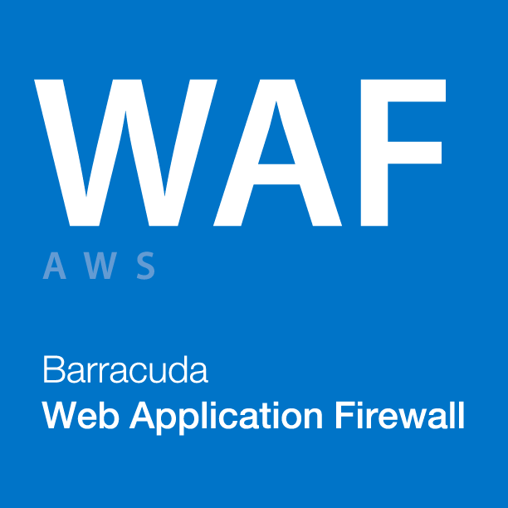

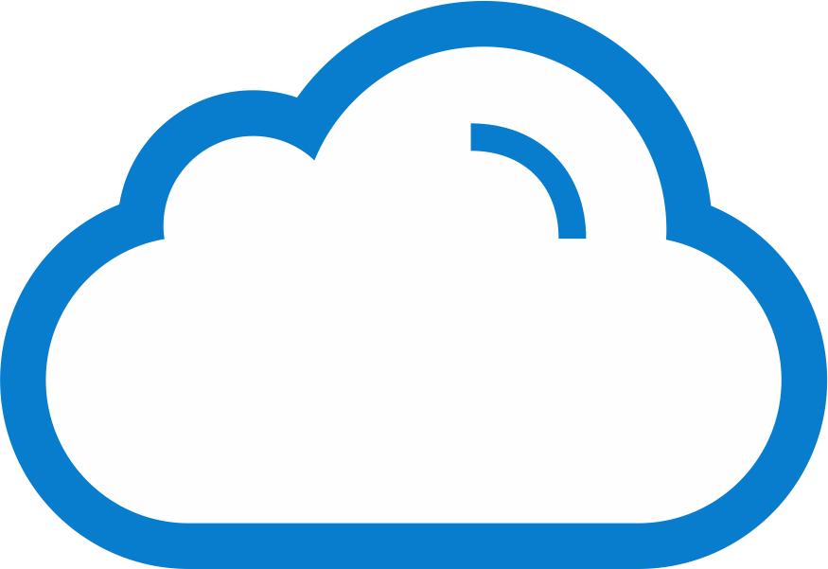

Engineered for AWS deployments
Auto-Scaling Group
Server 1
…
Dynamic Scaling
Virtual Private Cloud
Network Load Balancer
Network Load Balancer
Server N
Barracuda WAF Cluster
Notes:
As we have talked a lot about evolutions in cloud networking that have adjusted how we may deploy a firewall perimeter these have also improved how other security solutions can operate.
The initial AWS WAF autoscaling design looked like this …
However the new generation Network LB means our WAF can now fully utilize it’s abilities such as GEO-IP control and brute force prevention.
And while both clouds offer their own WAF technologies, you will find that the specialists in those areas can offer improved granularity of config, ease of use and more control.

Slide 17
Barracuda WAF-as-a-Service
Notes:
For those of you who haven’t needed to deploy and IaaS infrastructure, I’m sure you don’t want to start now. Which is why we have evolved our WAF offerings to include a PaaS option.
This can also all be managed programmatically, so in this demo I we are going to add some websites into WaaS to be protected. I already have a WaaS account but this can be provisioned from the Azure portal as PAYG if you prefer.
The script is going to boot up my webservers I made earlier, collect the public IP and it’s FQDN and then deploy my two websites to be protected into WaaS.
While this happens let me show you a little around the GUI.
As you may have noted there is a great deal of configuration that can be performed and you may ask how do I know what to configure first!
Demo the BVM against my website.
Show the WaaS in protective mode blocking a bad file upload.

Slide 18

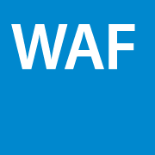
What is WAF-as-a-Service?
User (browser)
Customer Network
Barracuda Cloud Scrubbing Center (multiple locations worldwide)
Notes:
WaaS sits in our cloud datacentres, which allows us to manage it’s software updates, availability and scaleability for you. You are now responsible for your security configuration, administrative access and of course making sure that the connection between WaaS and your endpoints is locked down to prevent any circumvention of this security.

Slide 19



How it works
1-step setup: Point DNS record to DDoS service in WAF admin
Barracuda Active DDoS Prevention Datacenter
Customer Internet traffic
Barracuda WAF
Application Server
Notes:
It’s a really simple setup, you point your DNS at your WaaS IP, we point our WaaS at your secure endpoint and then we can start protecting your customer traffic.

Slide 20
Security Automation
Deploy
Scan
Remediate
Vulnerability Detection
BVM
Automated
Policy
BVRS
Templates
API driven orchestration
Auto scaling
Notes:
When you pair the Vulnerability Remediation Service tool with the API then you can now deploy security as part of your CI program. Deploy the site, scan the site, remediate the vulnerabilities, test the function.
This allows you to effectively assess the risk and decide whether to fix code or remediate with WAF.

Slide 21
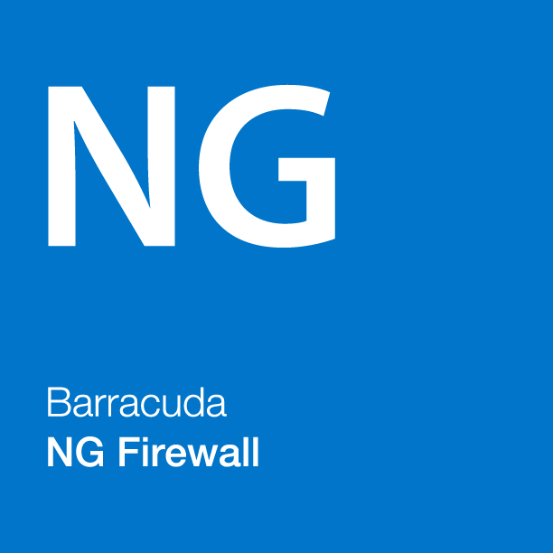
Deep Integration with IaaS/PaaS
Management & monitoring
Cloud Monitoring
Automation & Orchestration
Azure OMS
APIs
AWS Cloud Watch
DevOps Tools
Azure Security Center
Cloud Native
Integrations
Connectivity
Deployment
VPN connectivity at scale
Auto Scaling
Azure ExpressRoute
Templates
New Routing Requirements
On Premises
Notes:
Both WAF and CGF integrate deep with the cloud infrastructure to provide monitoring, scaling ….
However this security can only extend so far….

Slide 22
The Problem: Cloud Security is Complicated
“80% of future cloud breaches will be due to customer misconfiguration, mismanaged credentials or insider theft, not cloud provider vulnerabilities.”
- Gartner Group
Notes:
The entire cloud environment is a new set of skills and security control to be learnt. Each technology deployed will need different knowledge and different techniques.
As we saw looking at the evolution of security within IaaS using Firewalls new features will constantly change the environment we are trying to secure.
Multiple teams may be running different projects with different technologies, who is aware of everything that is happening?

Slide 23
New Threat Vectors = Your Own Employees
Insider Threats
are Commonplace, Hard to Detect
and Remedy
“Best Practices” aren’t Regularly Followed
Leveraging Cloud Services can Create New Vulnerabilities
User Errors can Compromise your
Environment
Notes:
This diversity, feature change and new product release means that potentially your own staff are now a risk to the security of the environment. The very ease of being able to implement something in a few minutes means that there may not be the time to research all the security implications. What worked for one deployment may no longer be suitable for the next.

Slide 24
Cloud Security Guardian – key benefits
Visibility of total Cloud Infrastructure
Automated Security Policy Enforcement
Remediates
Latent Threats
Eliminates Configuration Drift
Provides
Full Stack Security

Slide 25
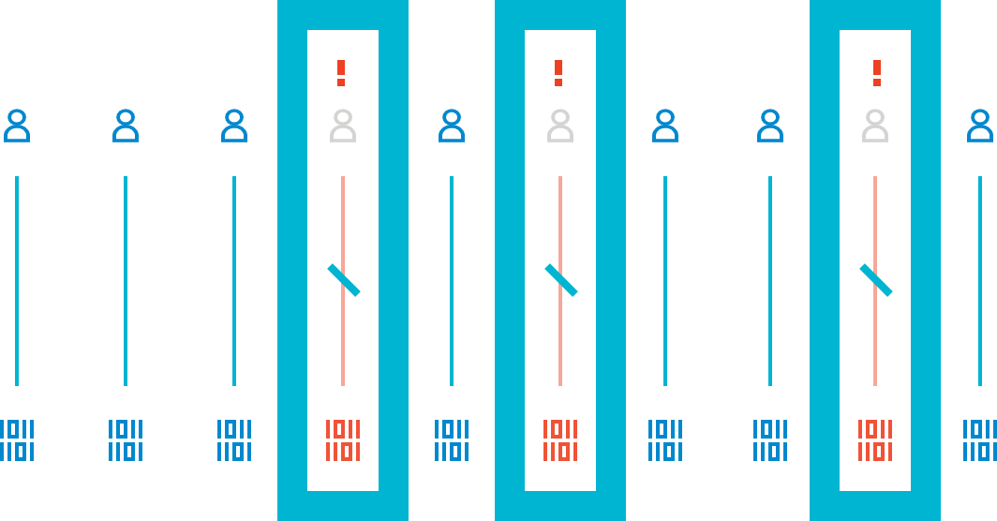
Eliminate Configuration Drift
Each Cloud Service can leverage different sets of rights and privileges
Very easy for developers to “drift” into non-compliance
Harder still to identify what’s happened and prevent it
Cloud Security Guardian will automatically alert, remediate, and report – taking the guesswork out of containing drift
Notes:
As we saw in my demo, a quick change to allow access to resolve a problem is easy to make. It’s also very easily for the person making that change to get distracted, forget to close the access and unintentionally leave a vulnerability.
With the Cloud Security Guardian constantly monitoring the environment it can alert you to errors such of these, taking this forward automatic remediation can become possible and holes closed as quickly as they are opened.
You entire team no longer need to become cloud security experts, this continual review against well established standards such as PCI-DSS, NIST and CIS can help protect you rcloud.

Slide 26
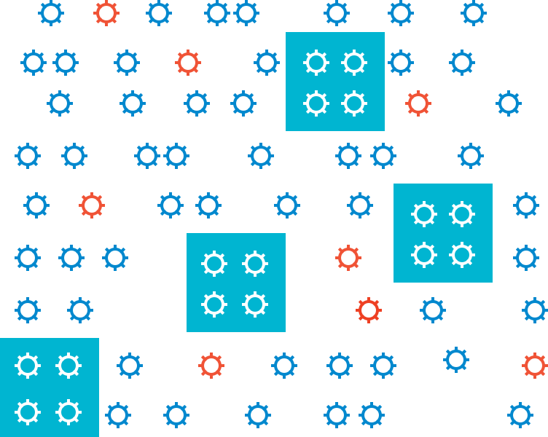
Full Stack Security
On-Prem security focused on management plane – cloud is different
Hackers target cloud mis-configurations and vulnerabilities at the control and data planes
Companies leveraging the cloud find they need to manage security for all three
Cloud Security Guardian applies security across the full stack – management, control, and data
Notes:
By focusing not just on the traffic flowing within and without your environment but addressing the entire cloud eco-system we can help eliminate risks early. As well as trace and educate teams about better practise.

Slide 27
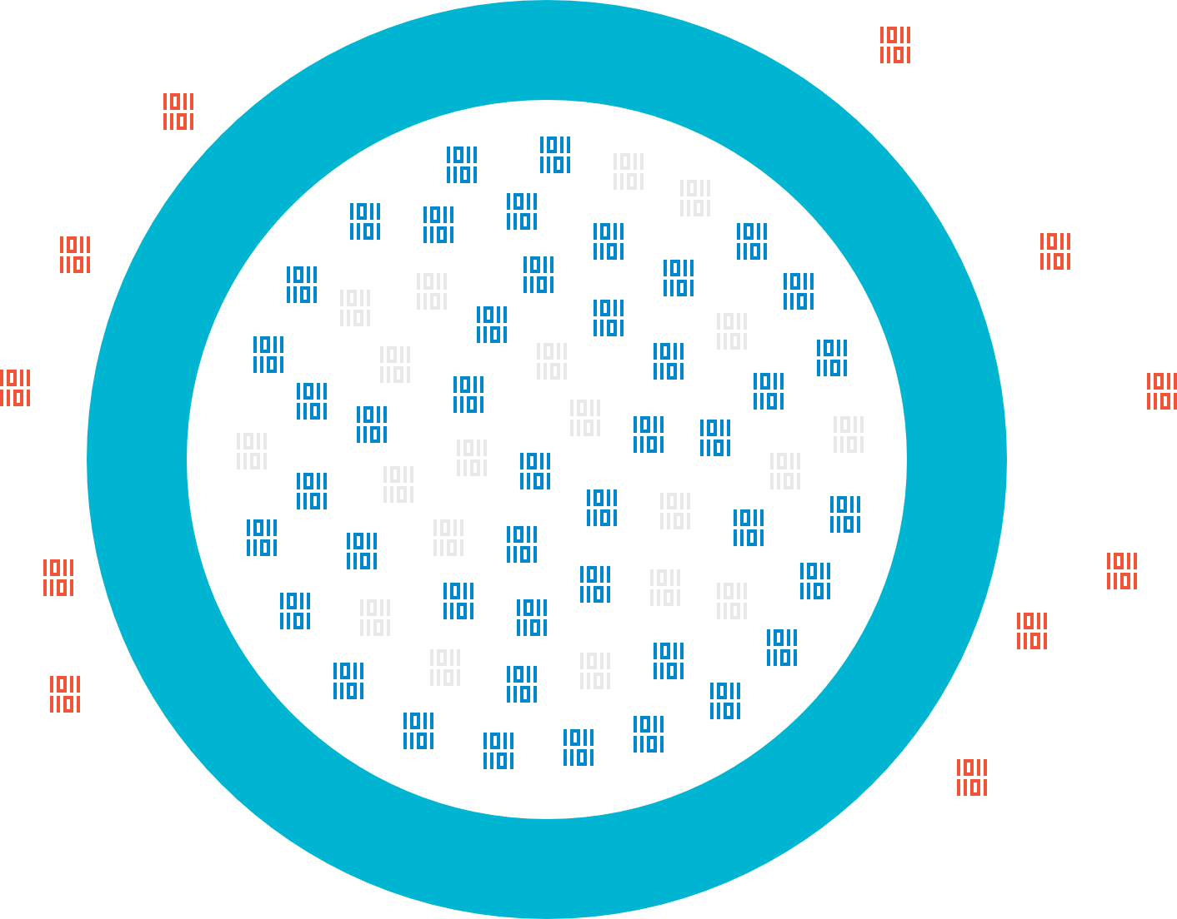
Eliminate Latent Threats
AWS Buckets and Azure Blog Storage can harbor latent threats
This malware is hugely destructive for businesses
Persistent threats continually target cloud storage
Cloud Security Guardian’s Cloud Storage Shield leverages ATP to scan and clean-up cloud stores

Slide 28
Cloud Billing
Traditional – BYOL (monthly, 1, 3 or 5 year terms)
Pair with reserved instances for cost effective long term security
Cloud – PAYG (pay hourly for what you use)
Scale up and down as you need more capacity.
Consumption – Metered (pay for what you use)
Integrate security throughout the CI cycle.
As a Service
Notes:
Please note consumption is AWS only and PAYG is not available yet in CSP subscriptions.

Slide 29

Resources
Barracuda WAF Module on Puppet Forge
GitHub Repository
https://github.com/barracudanetworks
Contact Barracuda’s cloud experts emeacloud_team@barracuda.com

